Slide 1




Overview of feed balance modelling
Presentation for Resilient African feed and fodder systems project— 2nd national feed inventory landscape and capacity building workshop
October 28, 2024
John Mutua

Slide 2
Objectives
Apply modelling methods to target countries to develop preliminary feed balance estimates and feed inventories
Validate model assumptions through field data collection in target countries
Build connections in-country to improve model assumptions
Build capacity in-country to continue to develop feed balance models

Slide 3
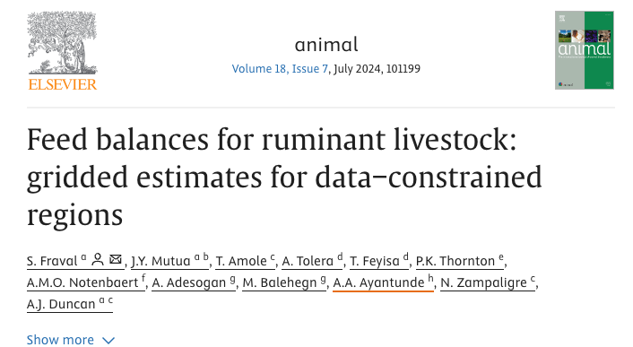
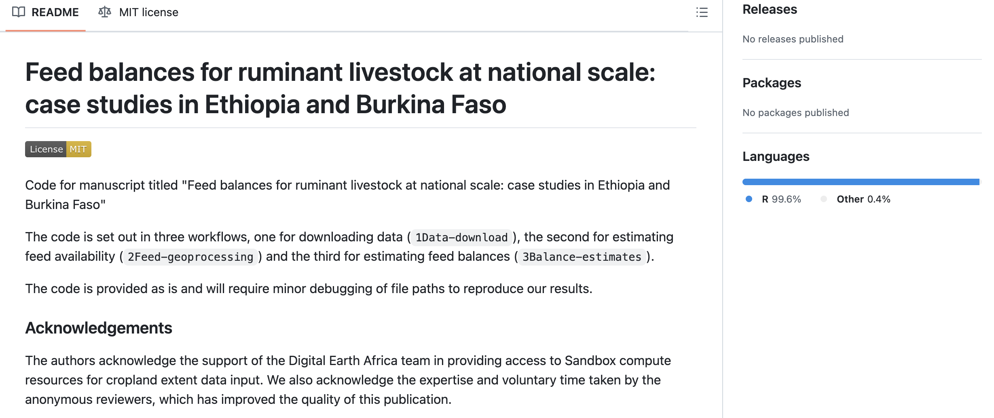
Methodology
Documented and published
Model is open access (R), GitHub
We plan to improve several aspects of the model e.g., Use dry matter productivity (DMP) data from FAO WaPOR

Slide 4
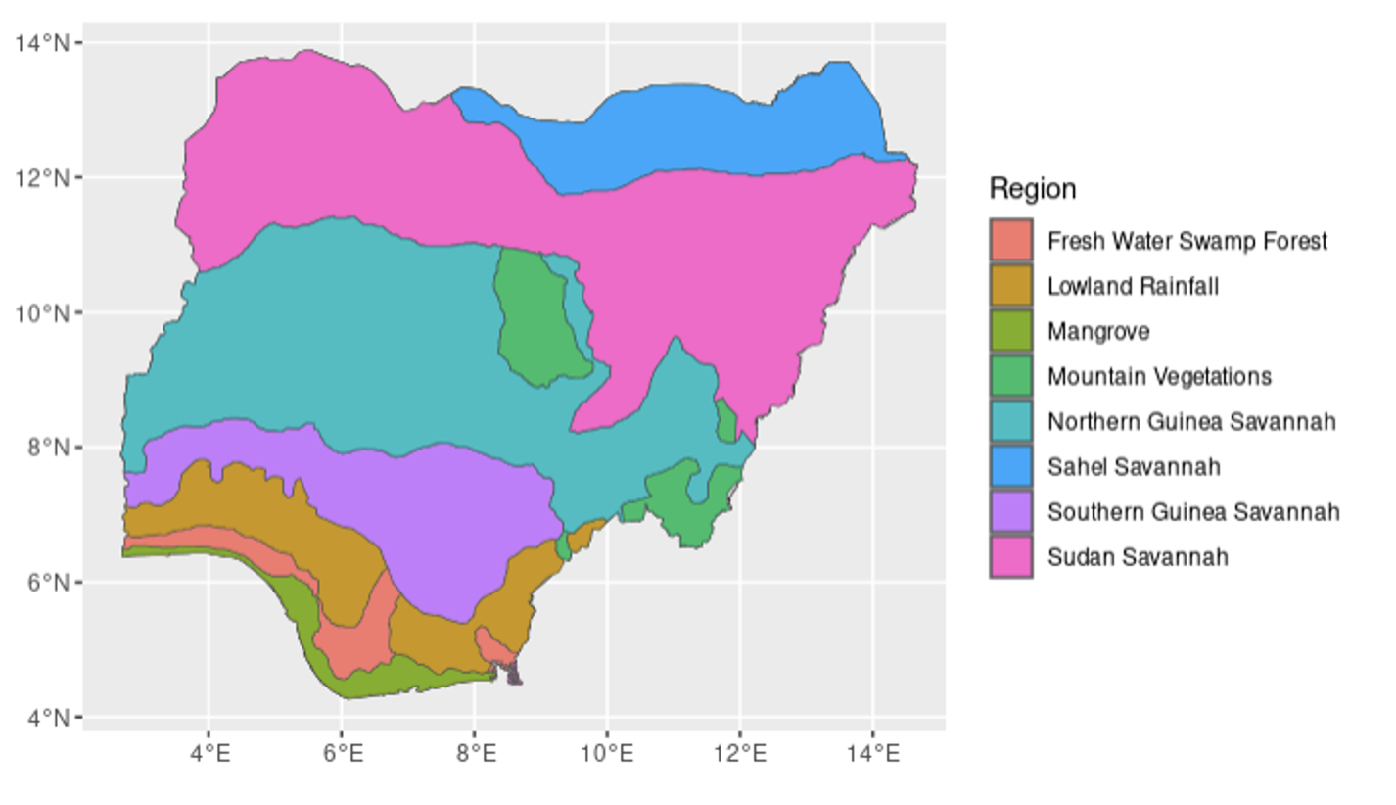
Defining aggregation units
Nigeria livelihood zones (FEWS NET)
Expert input
Define production systems

Slide 5
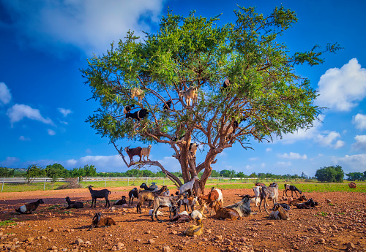
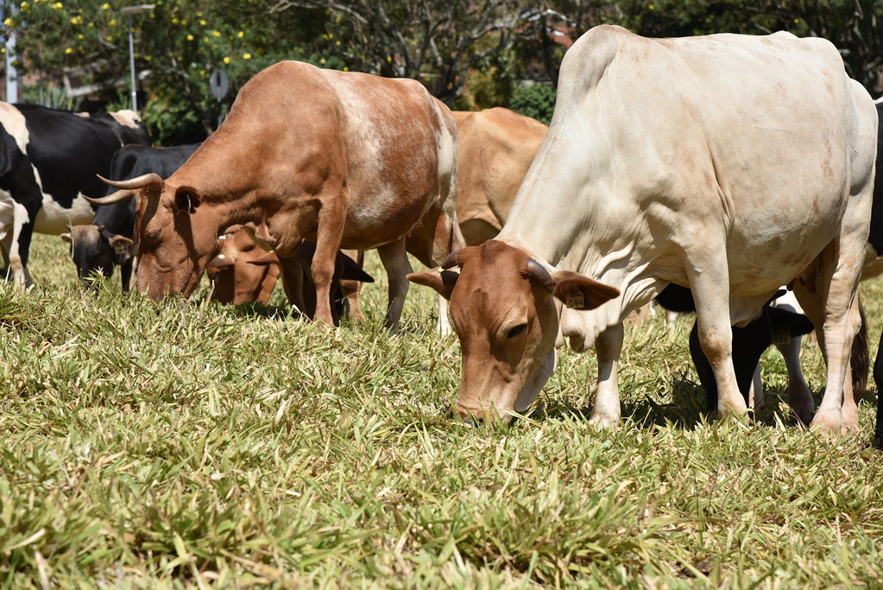
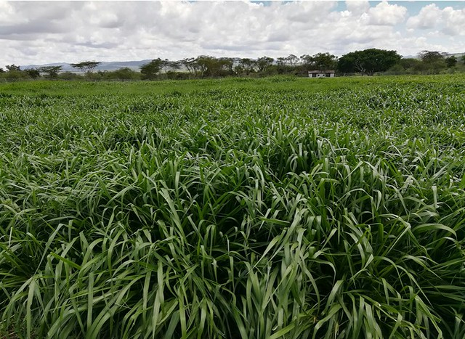
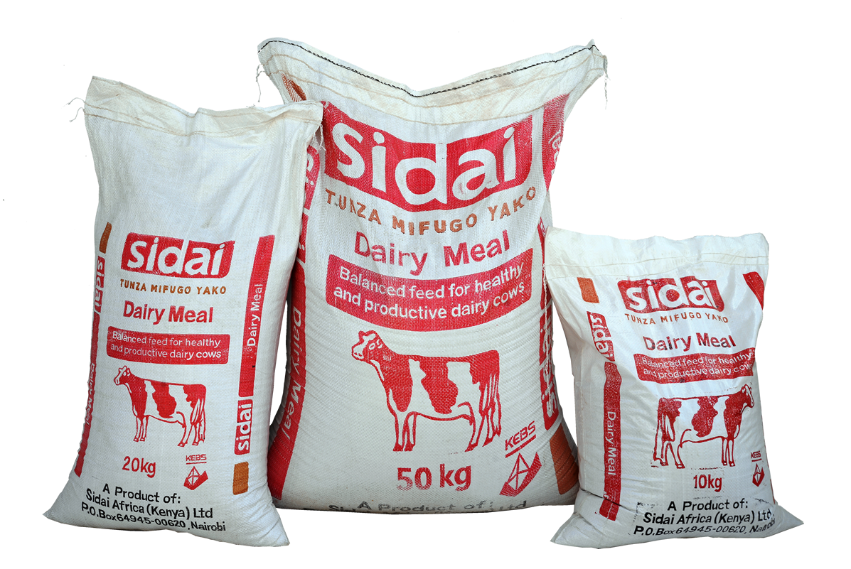
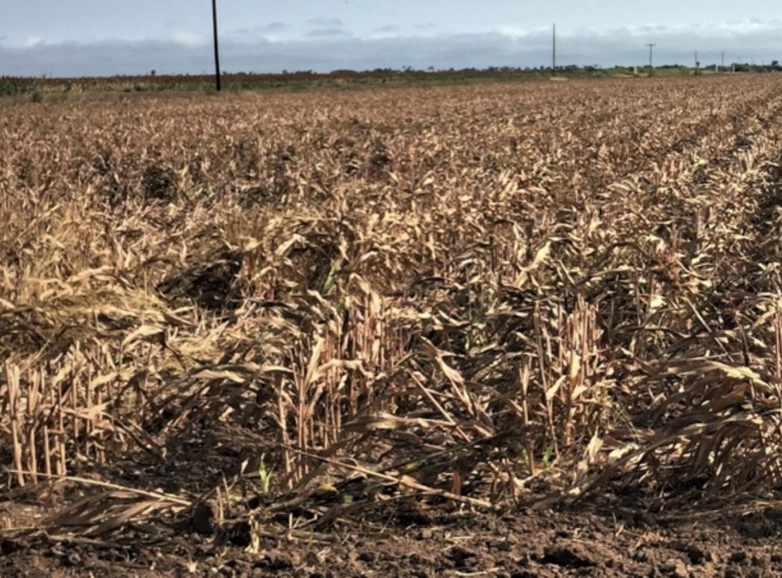
Feed items
Expert input
Define feed items by production systems

Slide 6
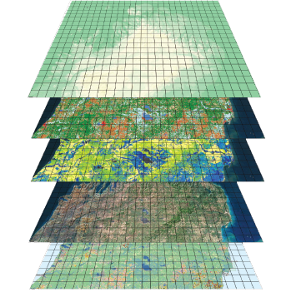
Estimating biomass availability
Biomass availability estimated using gridded products:-
Above ground dry matter productivity (DMP) - FAO WaPOR, Copernicus DMP
Land use - Fractional cover for cropland (Digital Earth Africa), grassland, shrubland and forest (Buchhorn et al., 2020), Fraction of grassland and shrub land covered by trees (Reiner et al., 2023)
Crop type and area - SPAM 2020
Biomass burning
Growing period - MODIS
Protected areas - World Database on Protected Areas (WDPA)

Slide 7
Feed energy availability
Dry matter productivity
Extract total above ground dry matter production (DMP) (kg/ha/day)

Slide 8

Feed energy availability
Dry matter productivity
Extract total above ground dry matter production (DMP) (kg/ha/day)
Exclude areas with burn scars and regions where grazing is restricted
Biomass burning
Grazing restricted areas

Slide 9
Feed energy availability
Dry matter productivity
Land use
Extract total above ground dry matter production (DMP) (kg/ha/day)
Exclude areas with burn scars and regions where grazing is restricted
Calculate start and end of growing season
Expert input
Biomass burning
Phenology
Start/End of season
Grazing restricted areas

Slide 10
Feed energy availability
Harvest index
Expert input
Extract total above ground dry matter production (DMP) (kg/ha/day)
Exclude areas with burn scars and regions where grazing is restricted
Calculate start and end of growing season
Attribute total DMP to pastureland and cropland (feedable crops)
Consider utilization factors and harvest indices for pasture and crops
Dry matter from cultivated forages and concentrate feeds could be estimated based on government statistics, published reports
Dry matter productivity
Land use
Biomass burning
Phenology
Feed composition
Grazing restricted areas
Pasture
Crop type
Cultivated forages
Concentrate feeds
Utilisation factors
Dry matter from
-Cultivated forages (Maps ???)
-Concentrate feeds (Maps)
Expert input
Expert input

Slide 11
Feed energy availability
Dry matter productivity
Land use
Feed energy concentration*
Extract total above ground dry matter production (DMP) (kg/ha/day)
Exclude areas with burn scars and regions where grazing is restricted
Calculate start and end of growing season
Attribute total DMP to pastureland and cropland (feedable crops)
Consider utilization factors and harvest indices for pasture and crops
Dry matter from cultivated forages and concentrate feeds estimated based on government statistics, reports
Apply metabolizable energy (ME) concentration per feed type
Biomass burning
Phenology
Grazing restricted areas
Pasture
Crop type
Cultivated forages
Concentrate feeds
*
*
*
*
Feed quality parameters by production system
-OM
-ME
-IVDMD
-NDF
-CP
Potential annual ME available
Expert input

Slide 12
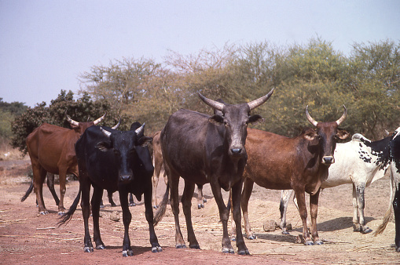
Livestock energy requirements
Using standard equations as per CSIRO (2008)
Requirements for maintenance growth, locomotion, gestation and lactation

Slide 13
Livestock energy requirements
Livestock population
Herd and flock disaggregation
Sheep and goats (Adult and young), Cattle (Bulls, steers, cows, heifers and calves), Horses, Mules, Donkeys and Camels
Livestock population estimated using gridded livestock of the world data and FAOSTAT
Expert input
Herd composition
Herd composition

Slide 14
Livestock energy requirements
Herd composition
-Weight
-Growth
Locomotion
Herd and flock disaggregation
Sheep and goats (Adult and young), Cattle (Bulls, steers, cows, heifers and calves), Horses, Mules, Donkeys and Camels
Livestock population estimated using gridded livestock of the world data
Estimate seasonal ME requirements for maintenance growth, locomotion, gestation and lactation
-Full term
-Milk yield
Draught power
Seasonal estimates
Other livestock parameters (by production system)
- Live weight
- Daily weight gain
- Fertility rate
- Lactation length
- Daily milk yield
- Maximum daily milk production
- Annual milk yield
- Daily walking distance
- Milk energy content (MJ/kg)
- Tissue energy content (MJ/kg)
Expert input

Slide 15
Livestock energy requirements
Herd composition
-Weight
-Growth
Locomotion
Herd and flock disaggregation
Sheep and goats (Adult and young), Cattle (Bulls, steers, cows, heifers and calves), Horses, Mules, Donkeys and Camels
Livestock population estimated using gridded livestock of the world data
Estimate seasonal ME requirements for maintenance growth, locomotion, gestation and lactation
Extrapolate ME requirements based on annual annual population statistics
-Full term
-Milk yield
Draught power
Seasonal estimates
Potential annual ME required

Slide 16
Feed balance
Dry matter productivity
Land use
Feed energy concentration*
Herd composition
-Weight
-Growth
Locomotion
Biomass burning
Phenology
-Full term
-Milk yield
Draught power
Grazing restricted areas
Pasture
Crop type
Concentrates
Seasonal estimates
*
*
*
Potential annual ME available
Feed balance
Potential annual ME required

Slide 17
Model limitations
Feed transport
Imported feed
Cross border transhumance
Inter-annual variability in crop and livestock parameters
Pastoral grassland utilization is not restricted by water point access

Slide 18
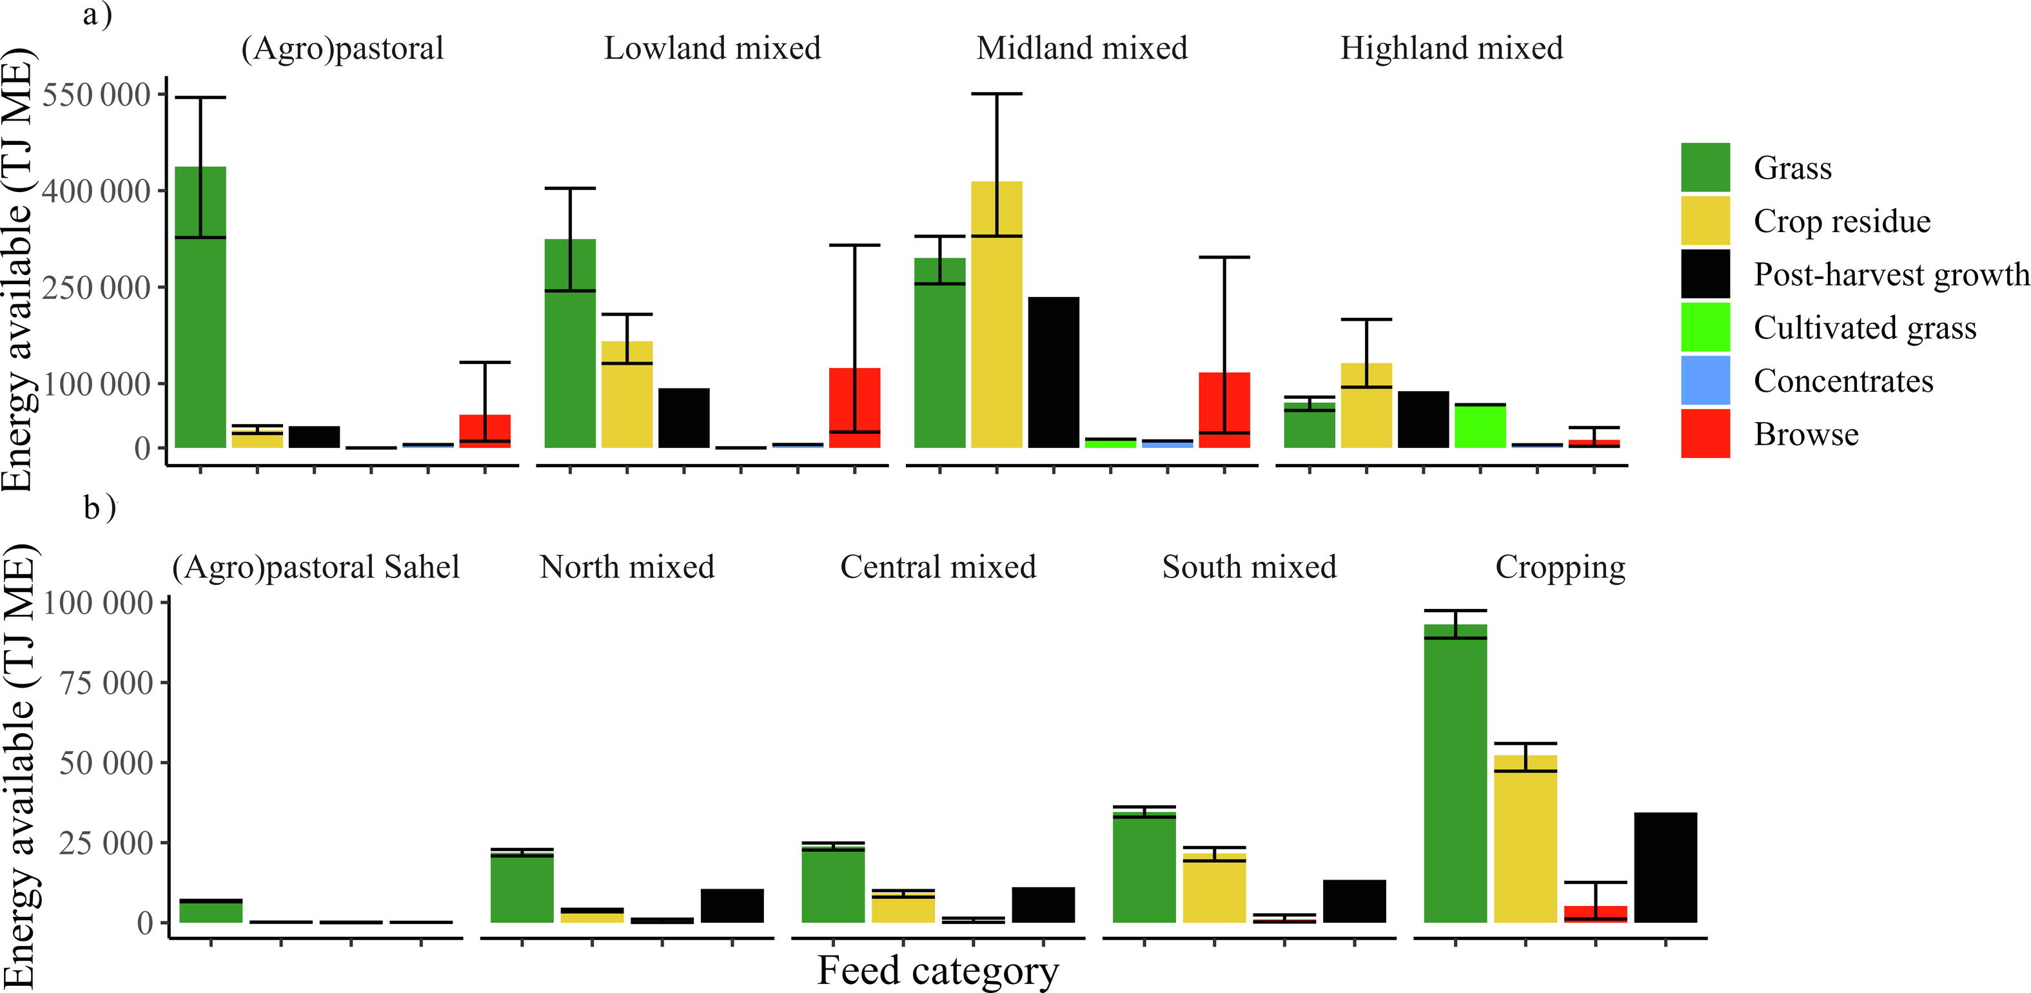
Feed energy availability
Ethiopia​
Burkina Faso​

Slide 19
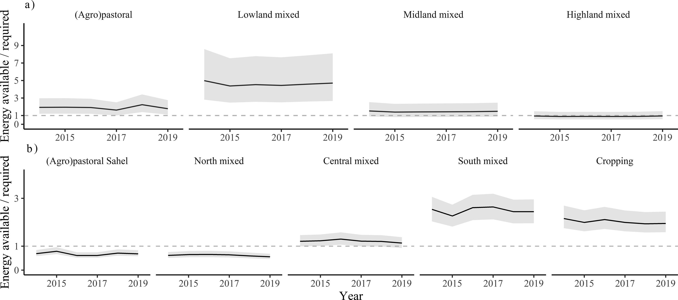
Feed energy adequacy
Ethiopia​
Burkina Faso​
* 1 = enough energy available to meet all ruminant livestock requirements

Slide 20
Findings- Burkina Faso and Ethiopia
Notable feed scarcity hotspots
Opportunities for feed trade
High uncertainty of browse resources
Influence of liveweight and milk yield
Seasonality impacts both side of equation

Slide 21
Thank you

